Slide 1
Donations for Citations UPDATE
Transportation Services Advisory Committee
May 3, 2017

Slide 2
April 3 – April 14
133 citations reduced
$3135
People donated more that the required amount
Some people just came by to donate
LOTS of good articles

Slide 3
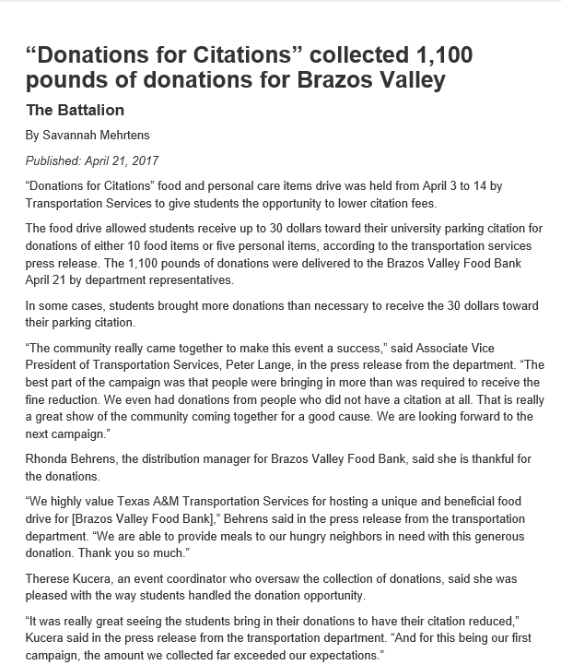
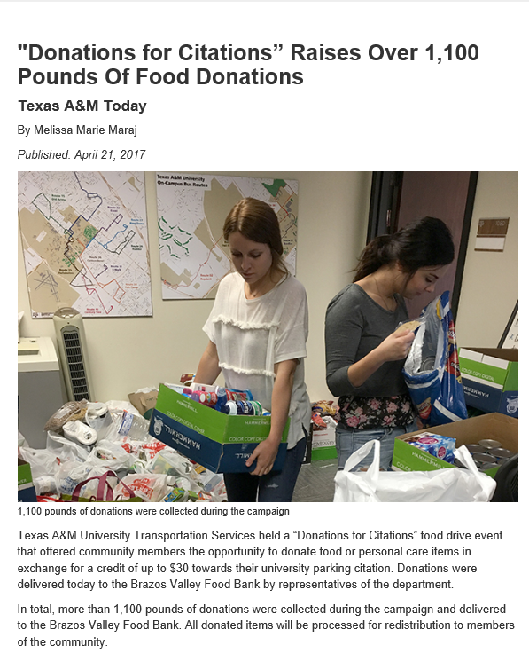

Slide 4
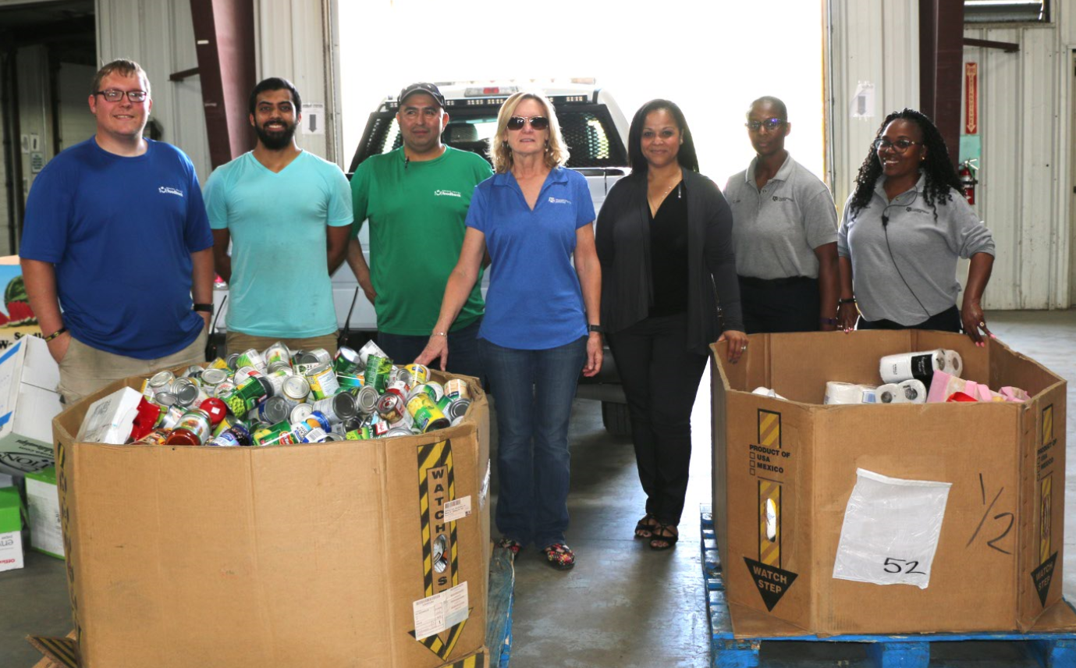
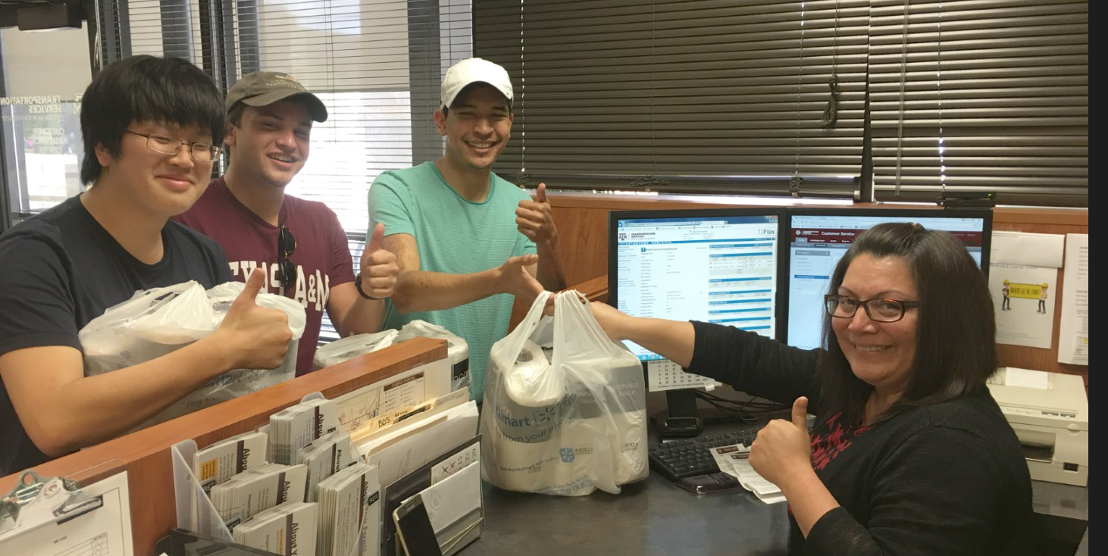

Slide 5
Self Releasing Boot UPDATE
Transportation Services Advisory Committee
May 3, 2017

Slide 6
FAQ Page Added To Website

Slide 7
Statistics
April 26 first boot on the ground
As of May 2 at 4:30 pm, 13 vehicles have been booted
10 paid and released
2 still due
1 Runaway
9 paid on line/1 paid in Koldus 108
8 self releases
2 assisted releases
Enforcement reports the boots are lightweight, easy to install and easy to remove.

Slide 8
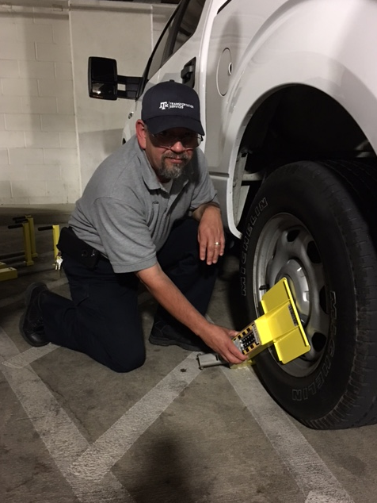
Training

